Slide 1

Dataflow Ingestion
Abalone dataset

Slide 2
ETL reading a csv file and writing to bigquery
Read abalone.csv file from GCS
Parse the csv file
Write the rows in the csv file to bigquery table.

Slide 3
The code snippets and flow
# Installing apache beam in gcloud cli
python3 -m pip install -q --upgrade pip setuptools wheel
python3 -m pip install apache-beam[gcp]
# Enabling dataflow service
gcloud services enable dataflow.googleapis.com
# Set up environment variables
export PROJECT_ID=$(gcloud config get-value project)

Slide 4
The code snippets and flow
# Importing the needed libraries as:
import argparse
import time
import logging
import re
import apache_beam as beam
from apache_beam.options.pipeline_options import GoogleCloudOptions
from apache_beam.options.pipeline_options import PipelineOptions
from apache_beam.options.pipeline_options import StandardOptions
from apache_beam.runners import DataflowRunner, DirectRunner

Slide 5
The code snippets and flow
# The Data Ingestion class defined to convert every row in the csv file in a format accepted by BigQuery
# First test locally with Direct Runner and once the code works as expected
# Run with Dataflow Runner that sets up dataflow job.

Slide 6
The Direct Runner and Dataflow Runner
# Direct Runner
python3 data_ingestion.py \
--project=${PROJECT_ID} \
--region=us-central1 \
--stagingLocation=gs://$PROJECT_ID/staging/ \
--tempLocation=gs://$PROJECT_ID/temp/ \
--runner=DirectRunner
# Dataflow Runner
python3 data_ingestion.py \
--project=${PROJECT_ID} \
--region=us-central1 \
--stagingLocation=gs://$PROJECT_ID/staging/ \
--tempLocation=gs://$PROJECT_ID/temp/ \
--runner=DataflowRunner

Slide 7
The Dataflow job in running status

Slide 8
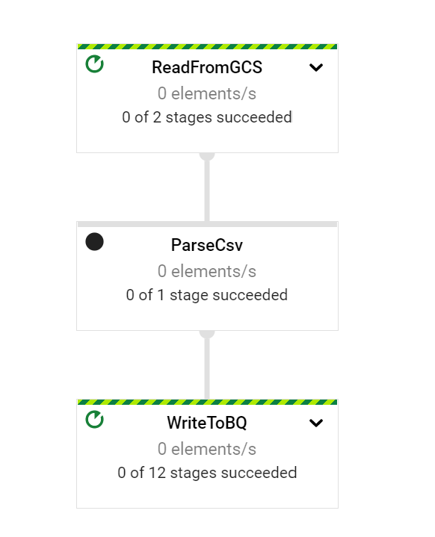
The Dataflow pipeline with all stages in running status

Slide 9
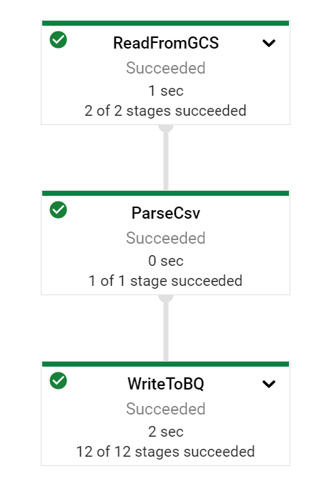
The Dataflow pipeline with all stages completed

Slide 10
The Dataflow job completed with success

Slide 11
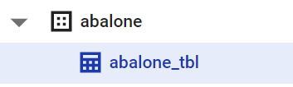
The Bigquery dataset and table

Slide 12
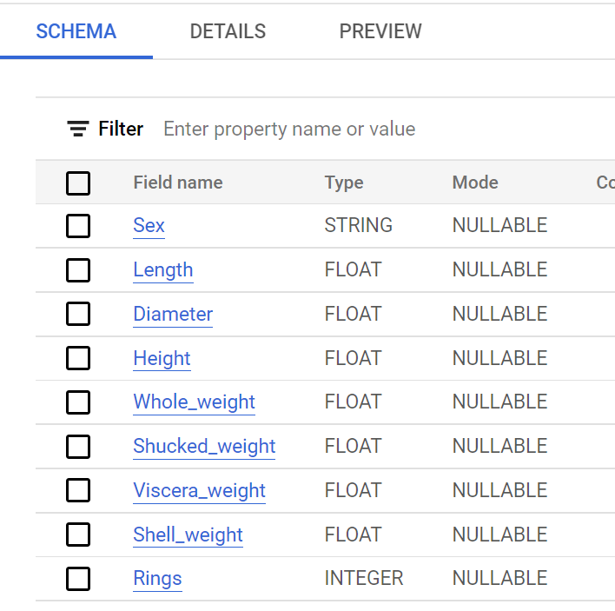
The abalone_tbl schema once dataflow jo successfull

Slide 13
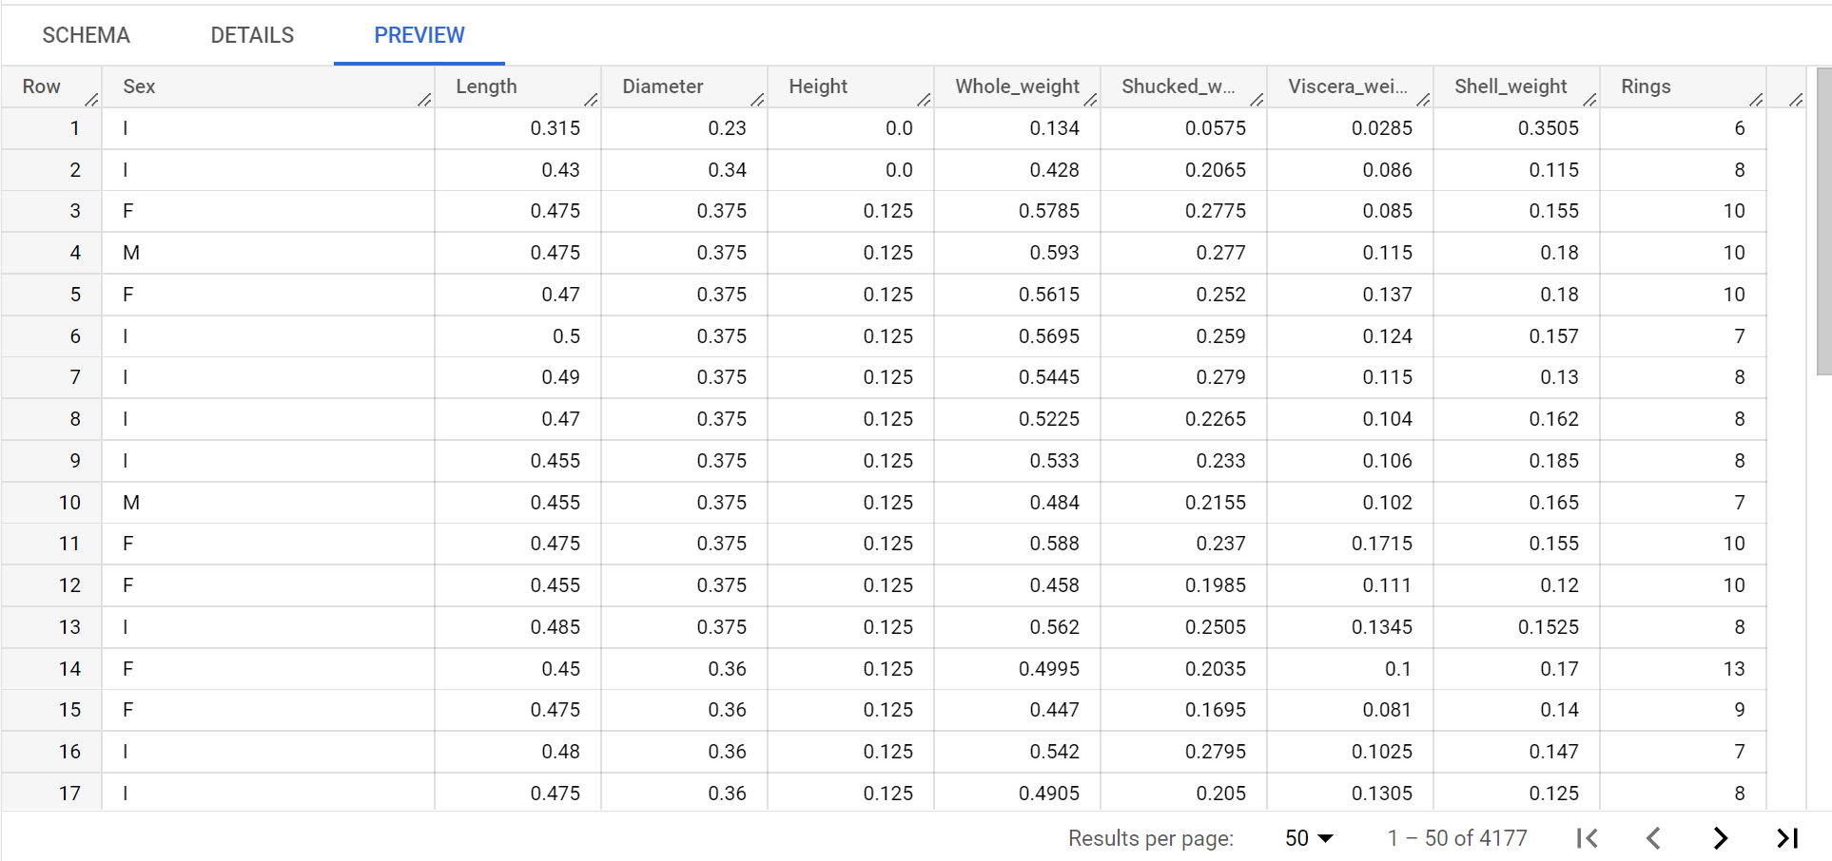
The abalone_tbl populated with data from the csv file

Slide 14
References
https://github.com/GoogleCloudPlatform/training-data-analyst/blob/master/quests/dataflow_python/1_Basic_ETL/solution/my_pipeline.py
https://github.com/GoogleCloudPlatform/professional-services/blob/main/examples/dataflow-python-examples/batch-examples/cookbook-examples/pipelines/data_ingestion.py

